Slide 1
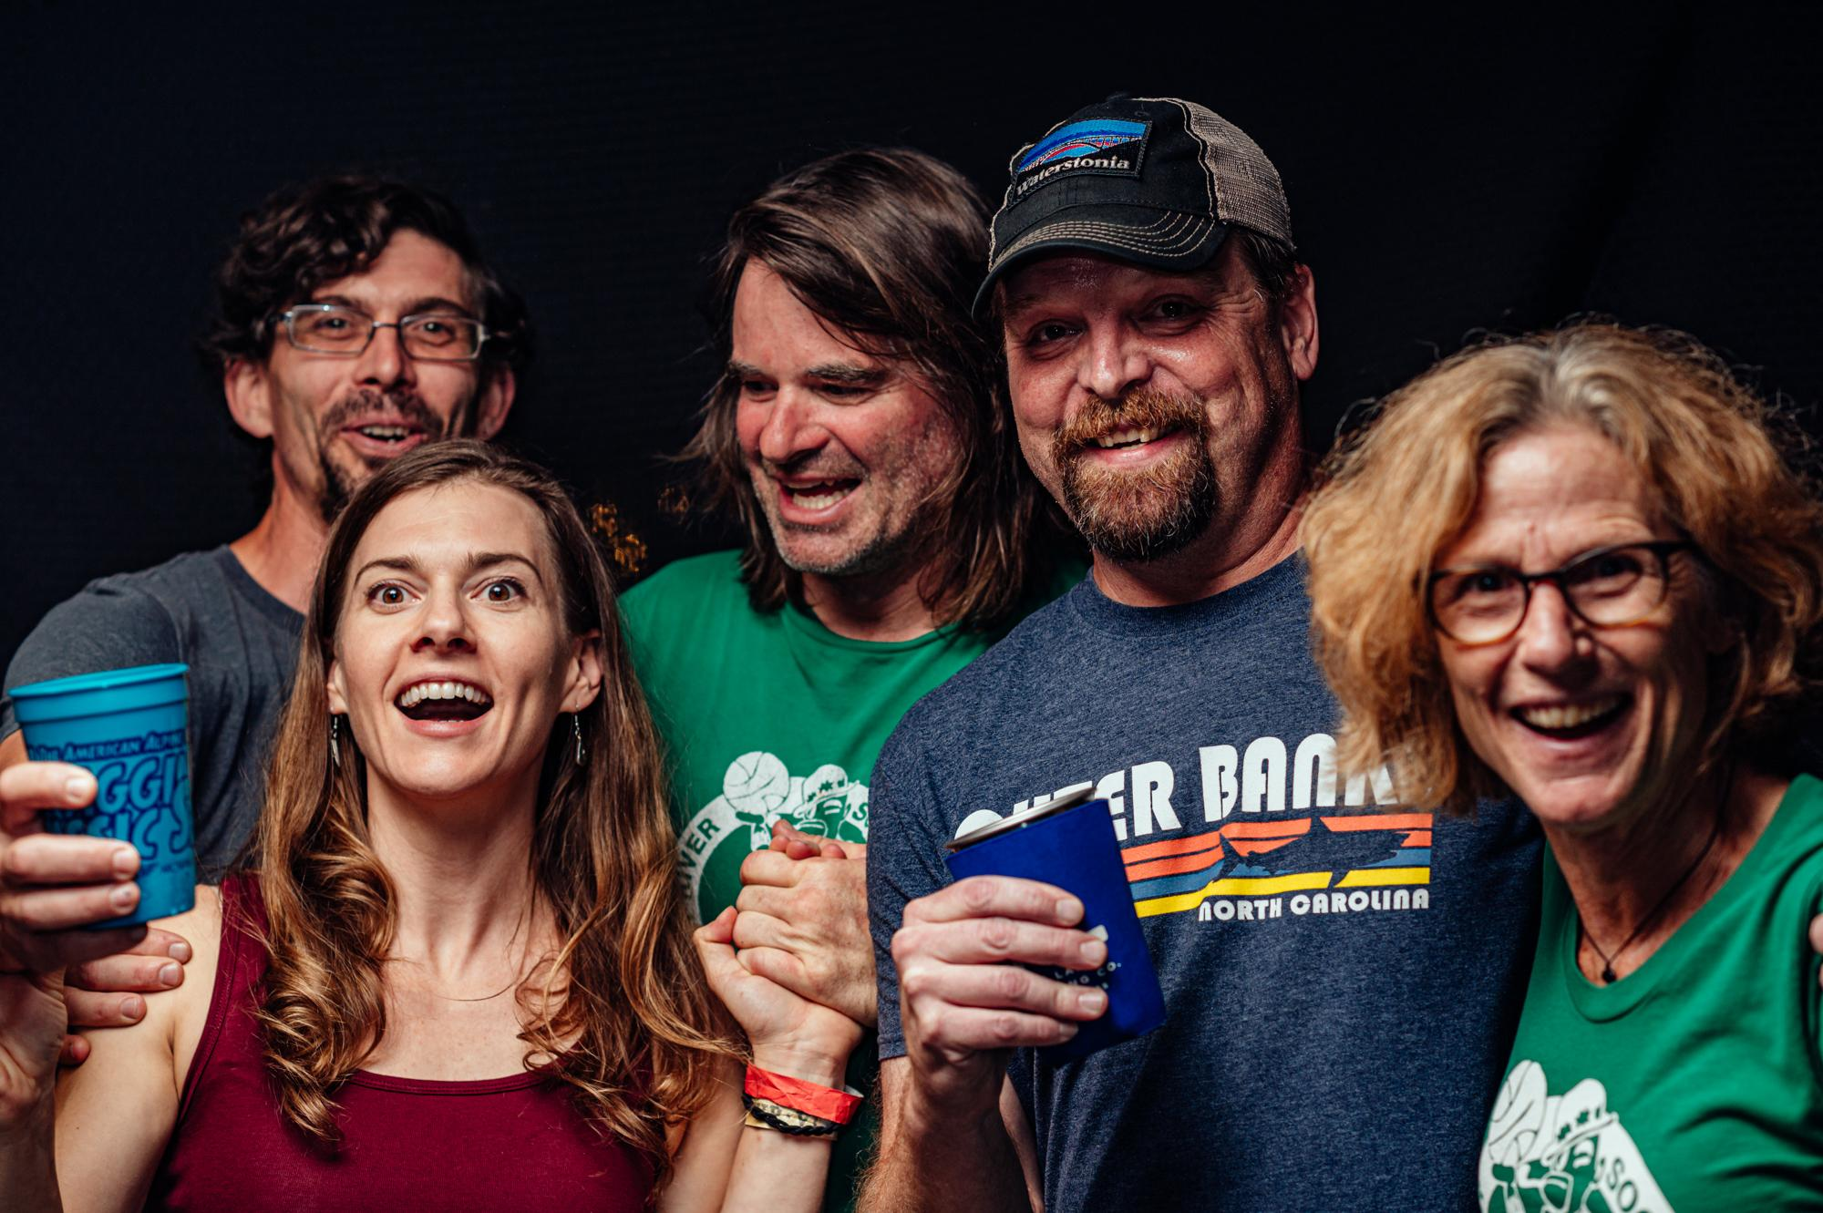
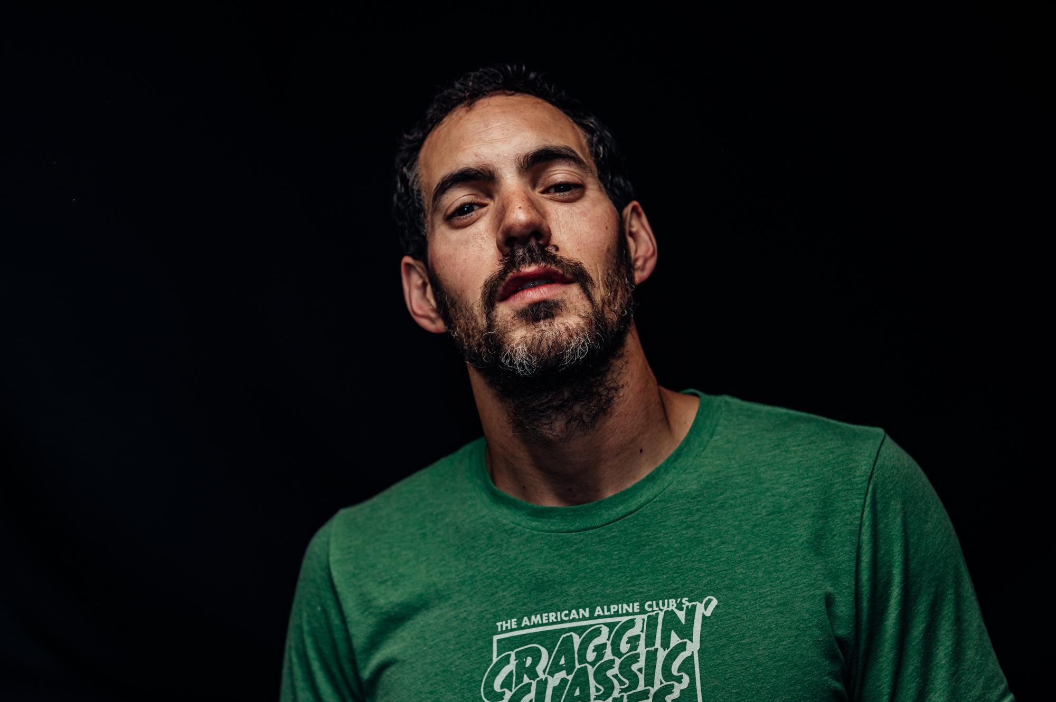
MEMBERSHIP TABLING

Slide 2
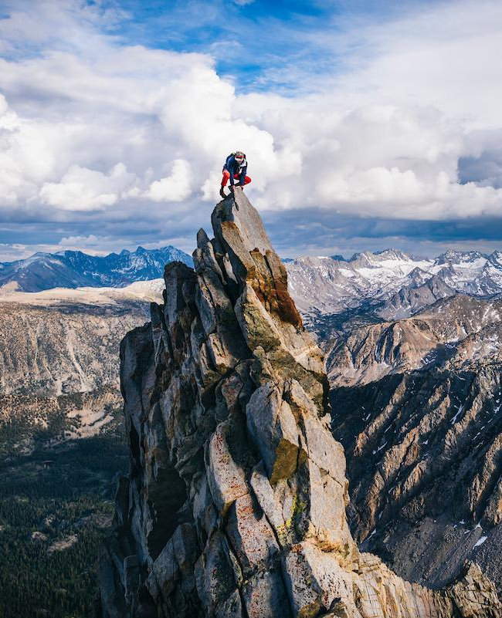
SELLING MEMBERSHIPS AT EVENTS
Membership is the primary revenue driver for the club and lends our programmatic work power
Speaking confidently and knowingly about AAC member benefits will instill confidence in prospective members
It’s best to harness the stoke already at an event to turn folks into members!
Notes:
Clearly, they love what we do and are stoked on being a part of the climbing community, so it makes sense that they should become members of the largest climbing organization in the country (26,000 members)
Membership dues are the primary way we support programming and operations of the Club

Slide 3
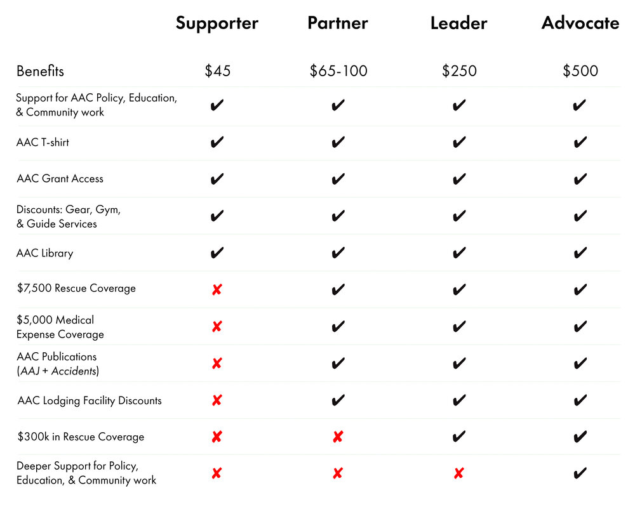
Notes:
Supporter = entry level AAC membership
Partner = “meat & potatoes membership”
Leader = for committed adventurers who want expanded rescue coverage
Advocate = for those looking to deepen their support for the club
We only sell Supporter > Leader at events

Slide 4
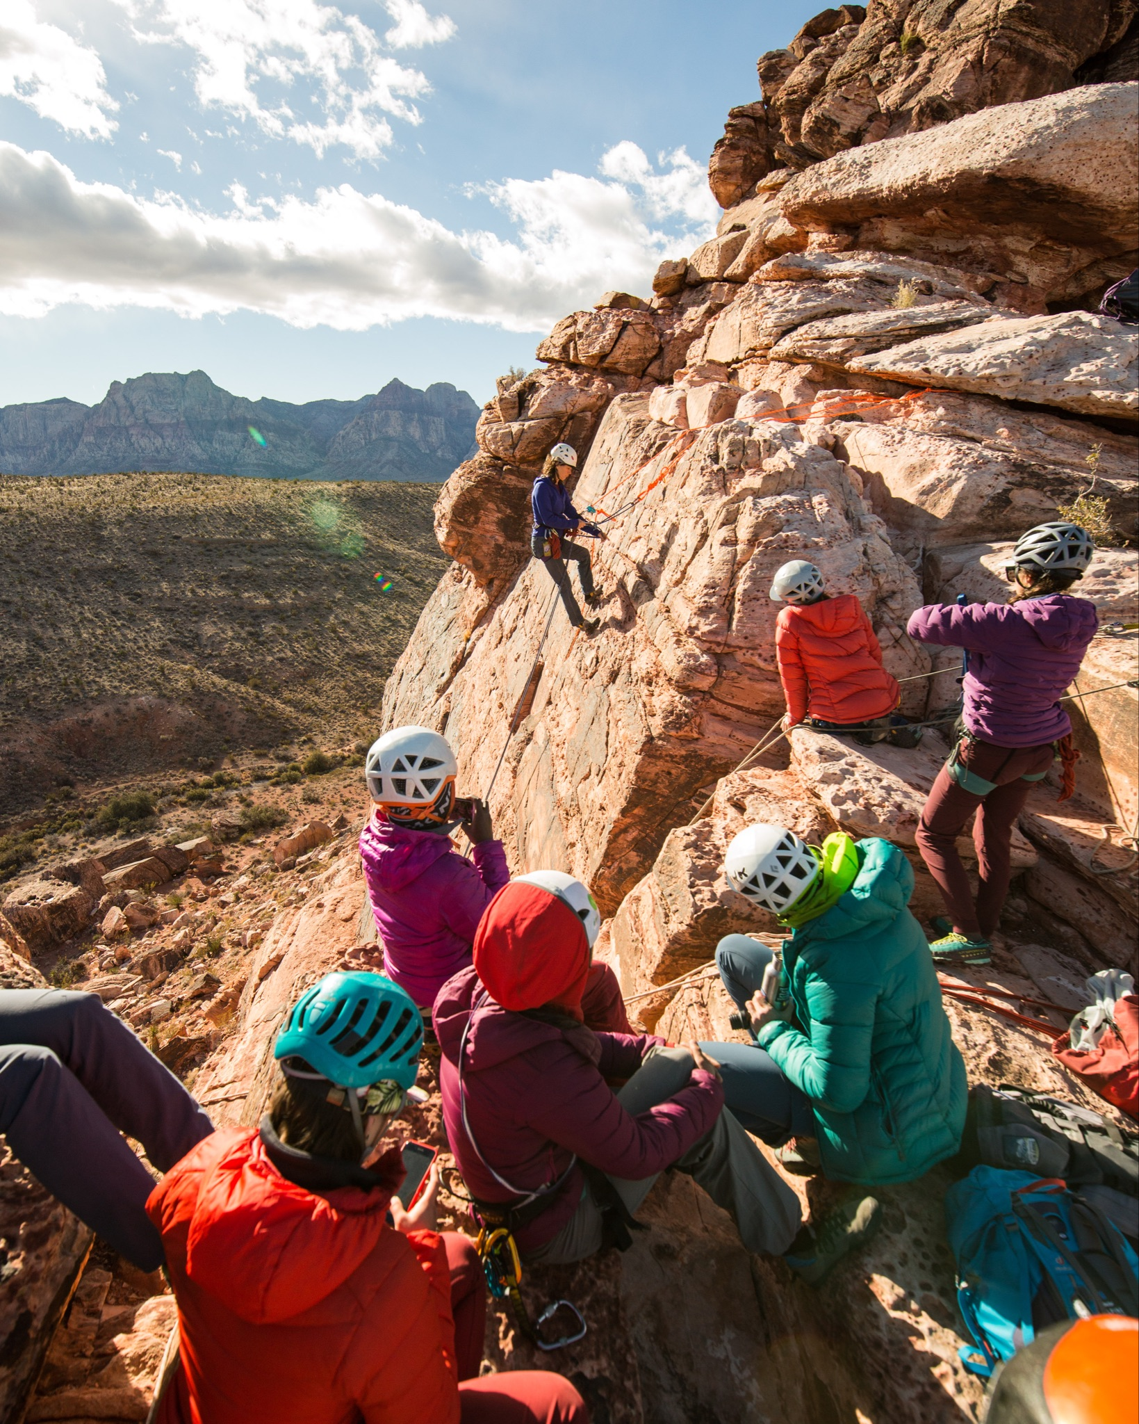
WHAT MOTIVATES NEW MEMBERS?
Top reasons partner members JOIN
Rescue and Medical Benefit (67%)
Discounts (38%)
Accidents publication (28%)
Notes:
Our rescue and medical benefit is the most unique offering we have, alongside our annual publications, and is clearly a large motivator for new and renewing members

Slide 5
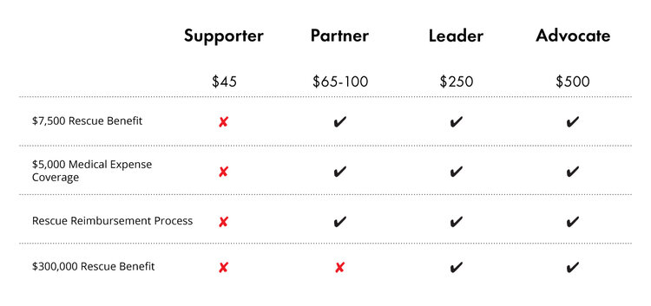
RESCUE AND MEDICAL
If you are an active AAC member looking to initiate a rescue, please contact Redpoint Travel Protection at: +1 628-251-1510
Benefit works worldwide, except for polar regions
No altitude restrictions
Not just for climbing!
Rescue coverage in the event of a medical emergency while recreating away from home that requires transportation to a hospital.
Medical coverage in the event that you are in the hospital after a qualifying accident and have out-of-pocket expenses related to emergency stabilization
Notes:
Everyone stop and enter this number in your phone!

Slide 6
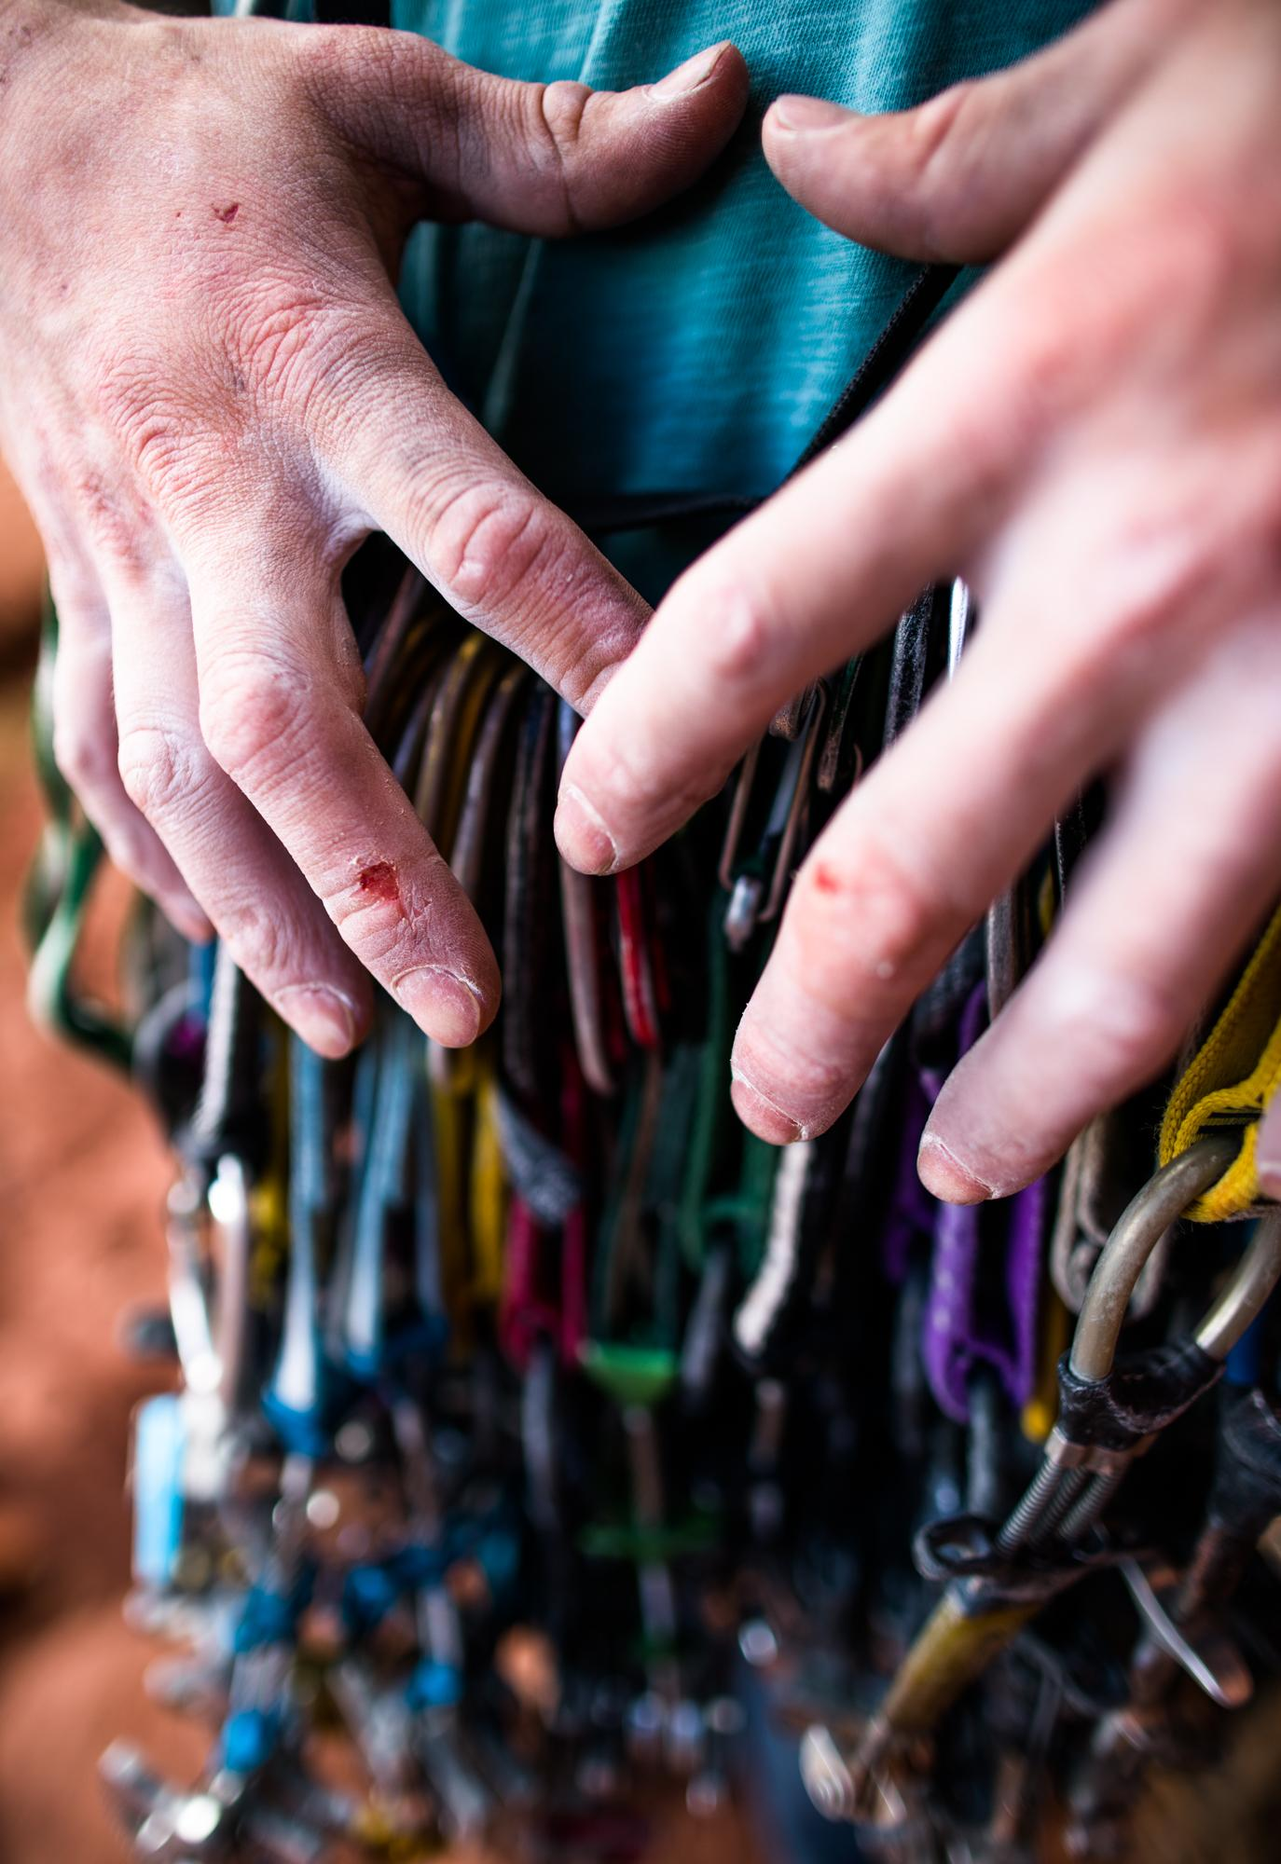
DISCOUNTS
Discounts
Gear (55 brands) + ExpertVoice access
Gyms (34 gyms, ~100 facilities)
Guide Services (28 companies)
Lodging
GARMIN • Outdoor Research • Mammut • Prana • Patagonia • Backcountry.com • Black Diamond • Cotopaxi • Smith • Rab • Sterling Ropes • Rocky Talkie • Big Agnes

Slide 7
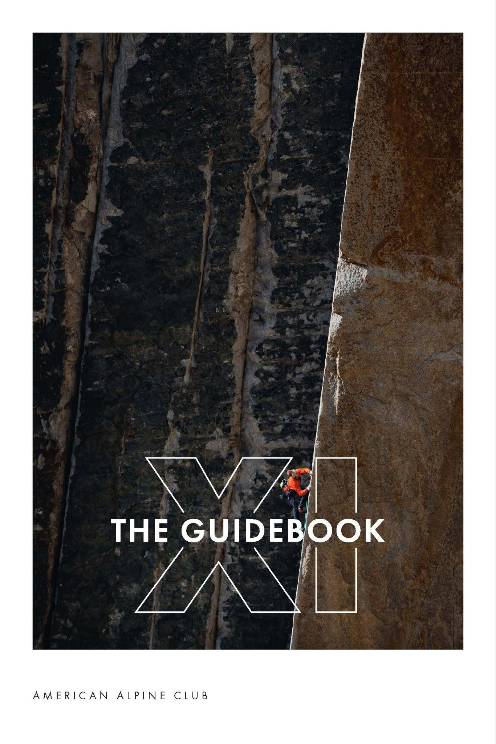
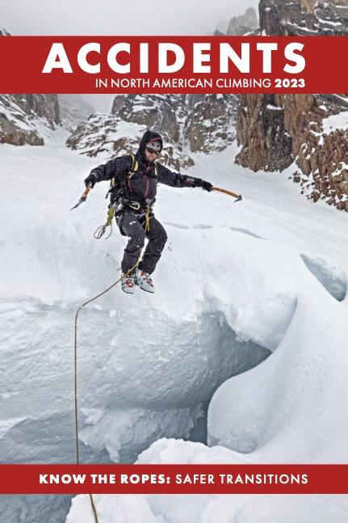
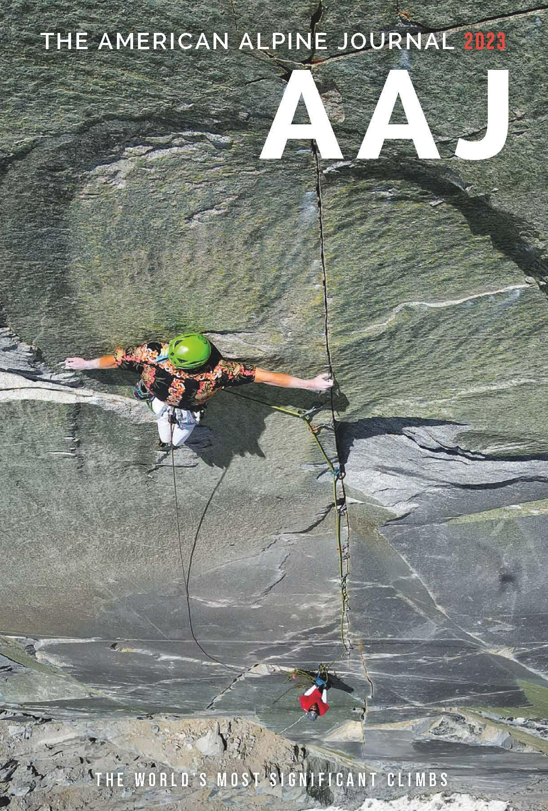
The Guidebook
Since 2011
Accidents in North American Climbing Since 1948
American Alpine Journal Since 1929
Mailed annually in late Summer, members at the Partner level and above can opt into physical copies of all three publications. Supporter level members can receive The Guidebook.

Slide 8
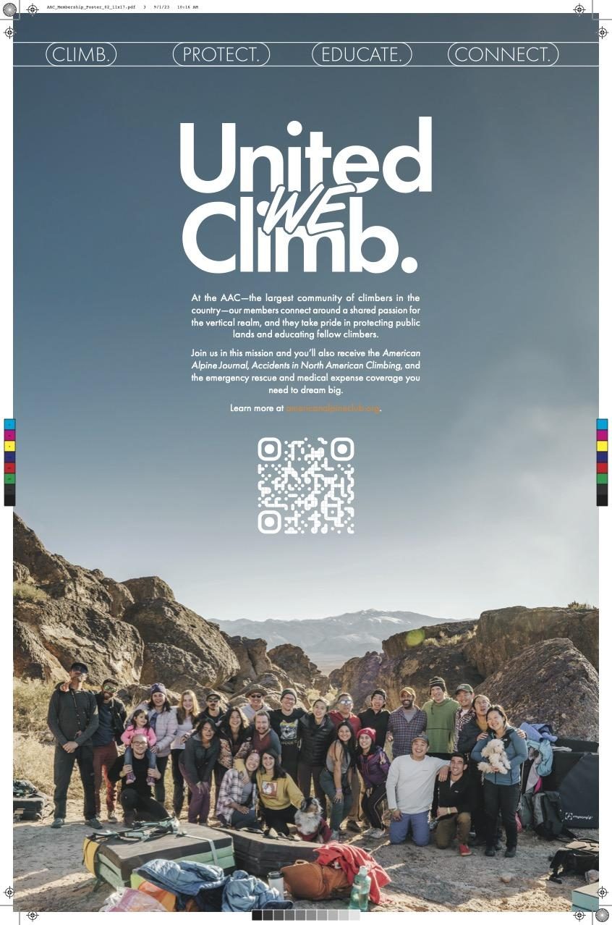
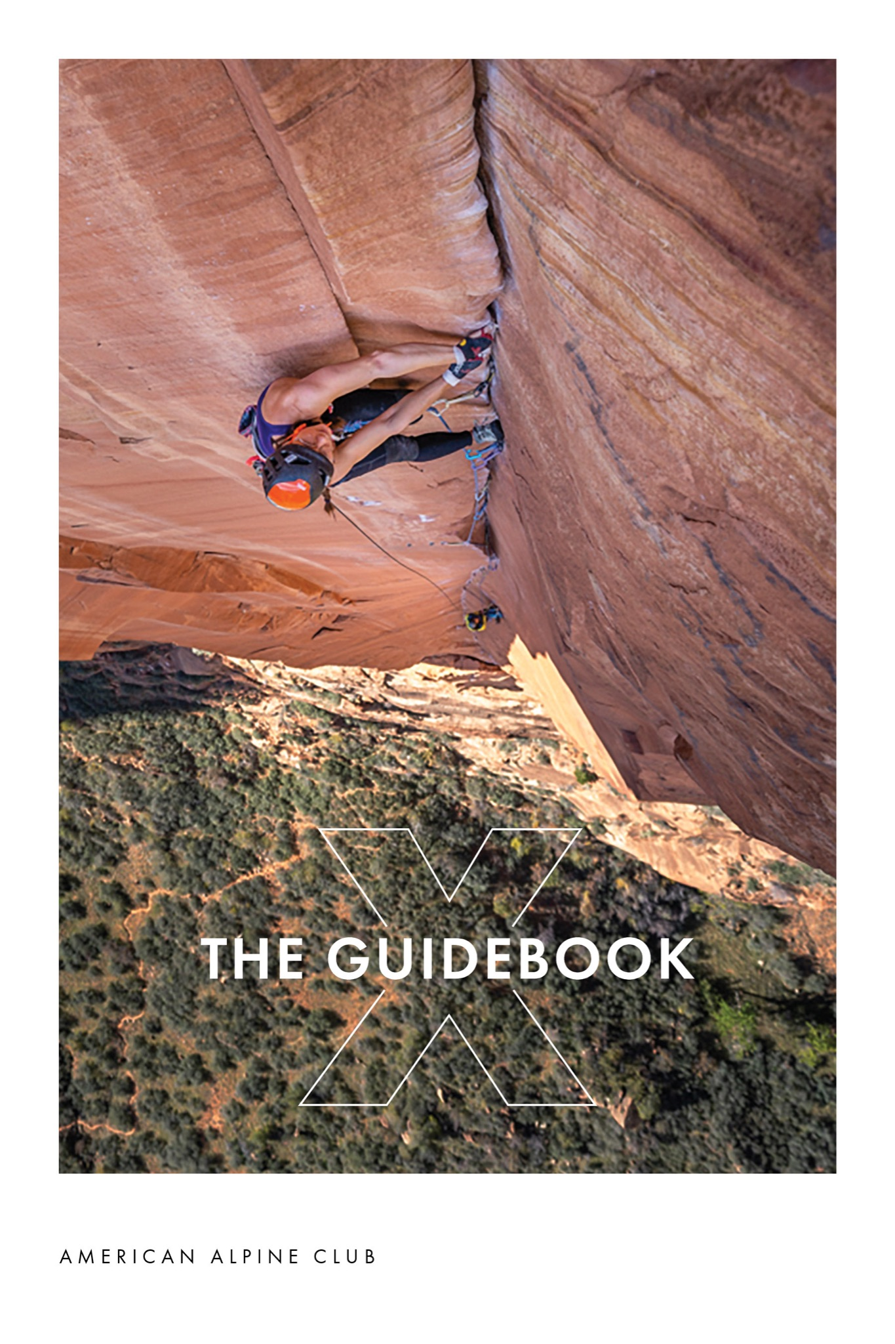
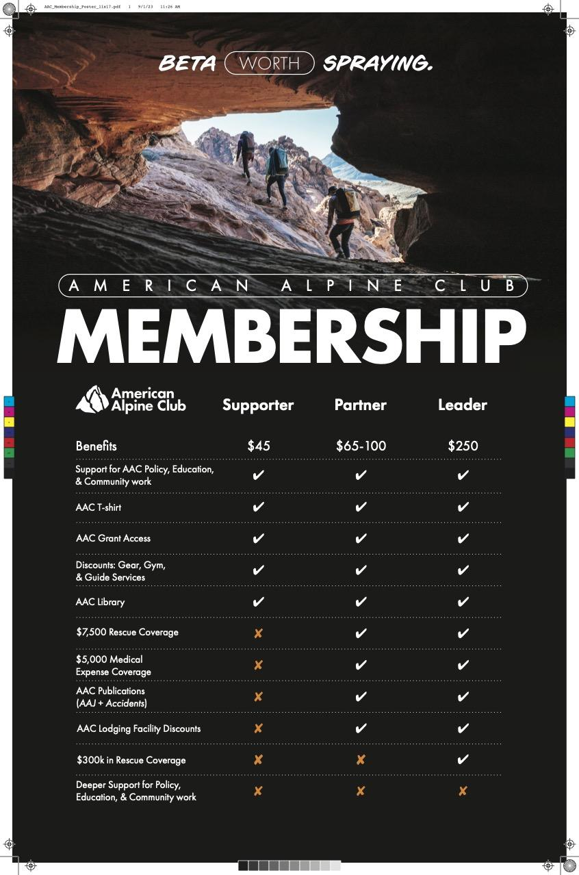
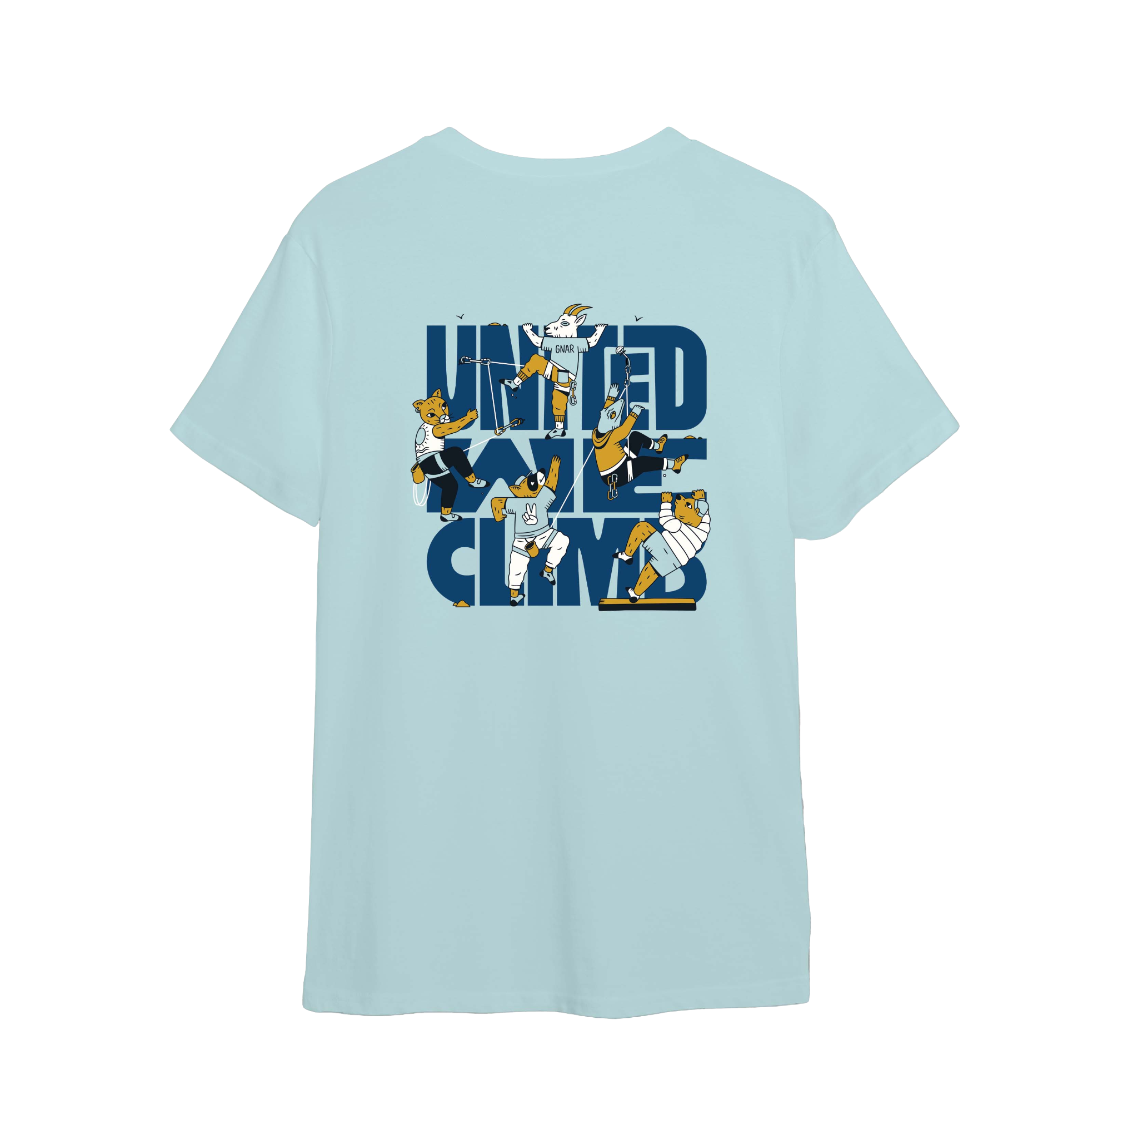
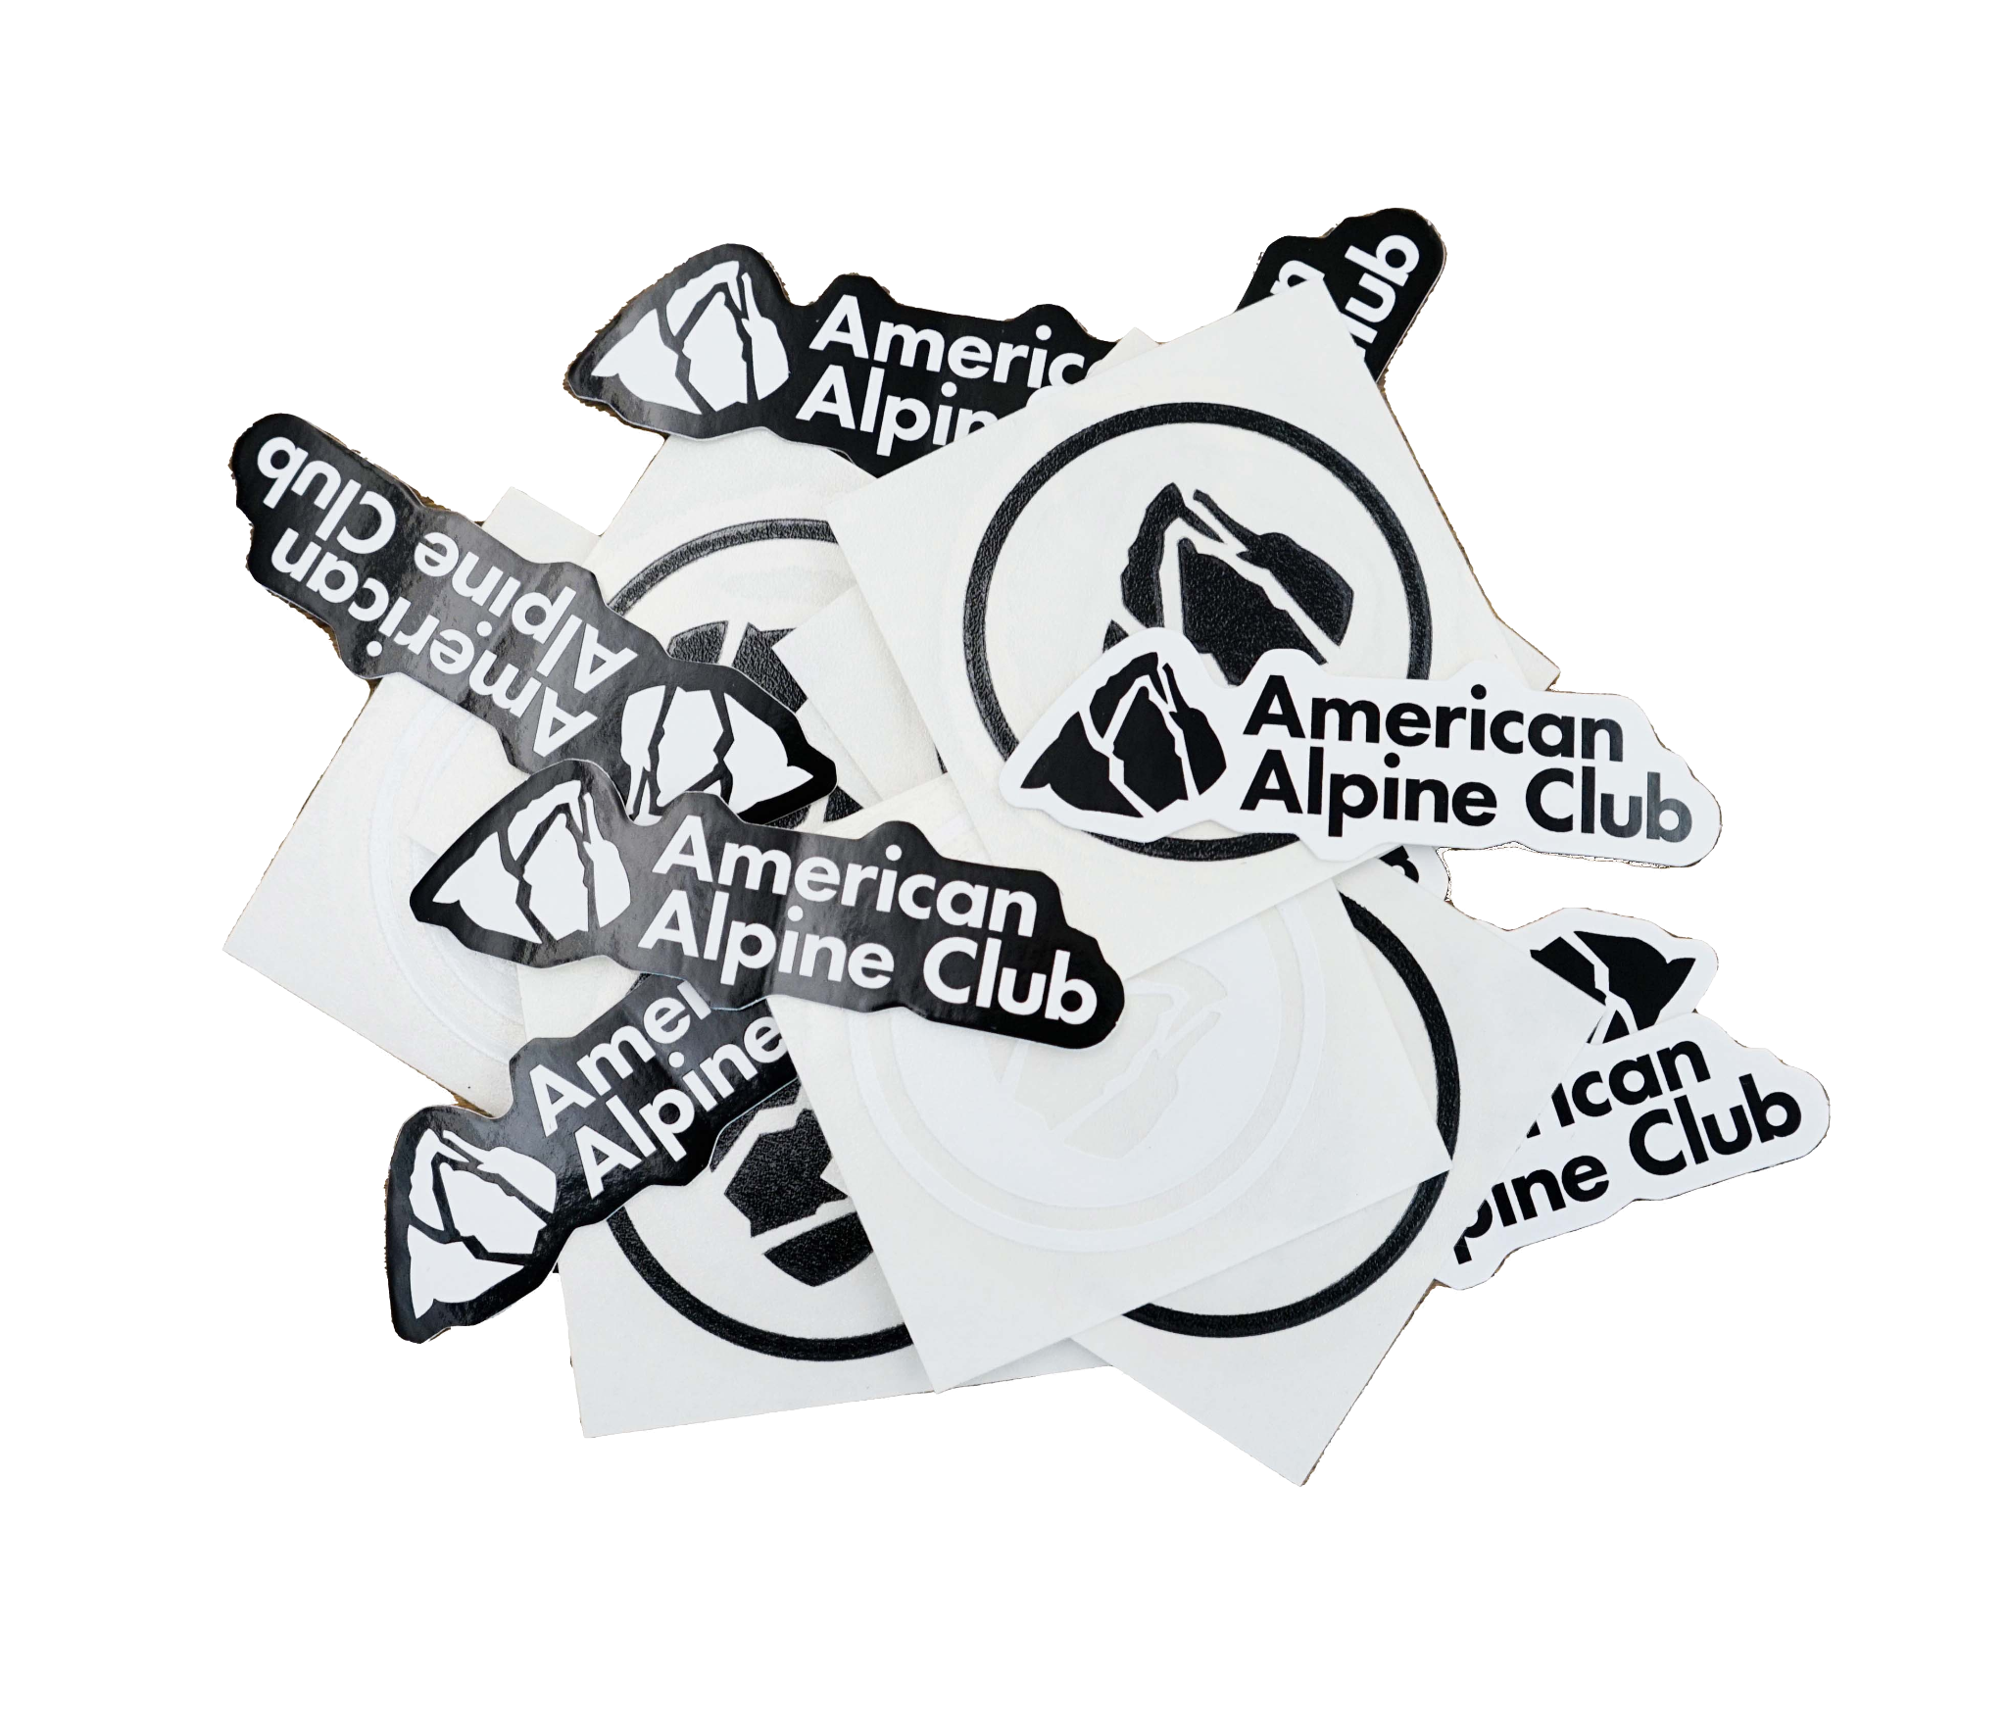
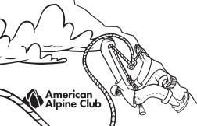
TABLING MATERIALS
Free!
Free!
Field sales guides
Posters
2023 Publications
2022 Guidebooks
Free!
Stickers
Field sales cards & sales kit
Member shirt
Notes:
Field Sales Guides - for handing out, great if someone wants to take time by themselves to reflect on member benefits
Posters - great for pointing to for visual member benefit reference, QR code for our learn-more page
Publications - incredibly special! Come for free with partner and above memberships, the club’s longest legacy, published and created entirely in-house
2022 GBs- for handing out! Amazing photography and storytelling about the climbing community, please encourage folks to grab a copy
Stickers - self-explanatory
Field sales cards - must be associated with a membership transaction, customer MUST scratch off code and enter it on website to join the club, not active until then
Member shirt - for enticing people! Not for handing out
*Be sure to download the square app!

Slide 9
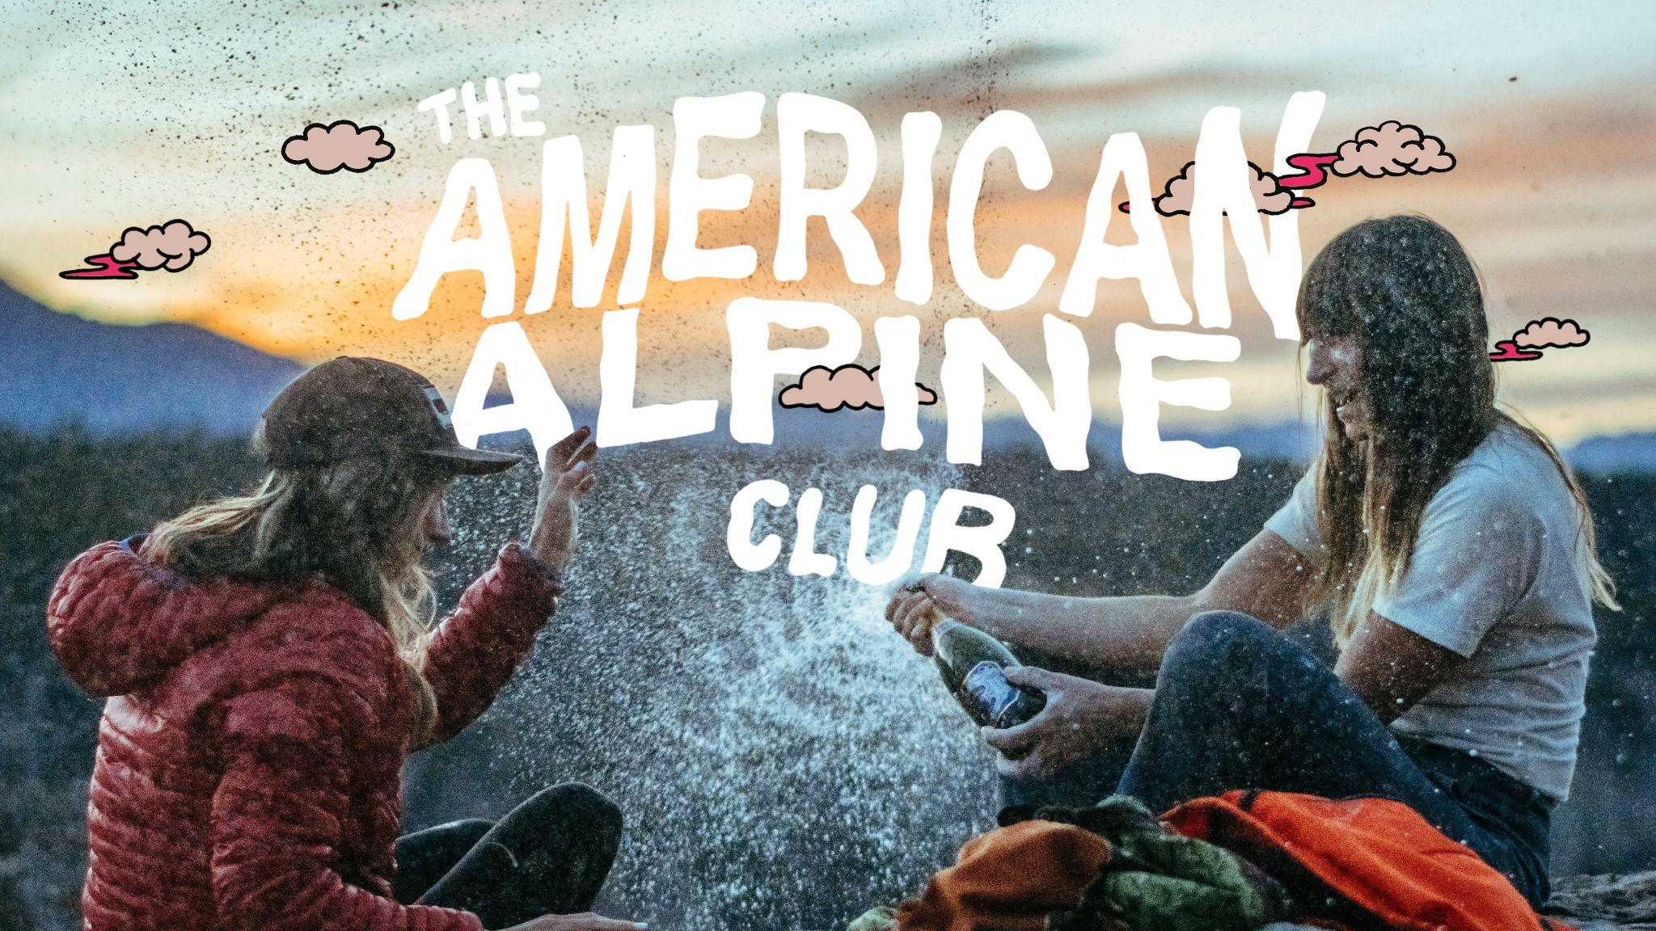
Notes:
Questions?

